Slide 1
Welcome to the Parent Teacher Organization General Body Meeting
November 16, 2021
We will begin shortly… please add your child’s name and teacher to the chat in order for your student to receive extra credit for your presence on the call

Slide 2
Agenda
Opening Prayer and Comments
Treasurer / Fundraiser Report
Introduction of Classroom Parents
Closing Remarks

Slide 3
To All our
fundraiser participants
Fundraiser Champions:
Ms. DeSue and
Carressa Hutchinson

Slide 4
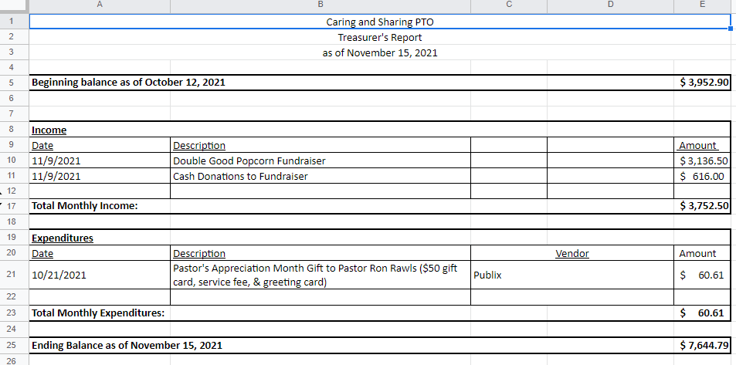
Treasurer Report

Slide 5
Classroom
Parents
Name | Grade | Email
Robert Young II | VPK | mrrob2u78@yahoo.com
Breanna Mervin | K | mervinbreanna@yahoo.com
Marianna Knight | K | knight231994@gmail.com
Carjie Scott | 2 | carjamin_scott@yahoo.com
Latoya Lopez | 2 | ltlhd1@gmail.com
Logan McCone | 3 | mcconelogan1@yahoo.com
Erin Thomas | 3 | erin.kazanis@gmail.com
Shanavia Cason | 5 | scason253@gmail.com
Bakari McClendon |  | cslsbmcclendon@gmail.com
Ashley Tensley |  | tensleyashley@yahoo.com
Reminder: Parent Volunteer Orientation
Thursday, November 18th at 7pm

Slide 6
Remaining PTO Meetings for the school year
January 18, 2022
March 15, 2022
May 17, 2022
All meetings are via Zoom and begin at 7pm

Slide 7
Thank you for coming!
The PTO can be reached at any time at cslspto@gmail.com

