Slide 1
CARING AND SHARING PARENT TEACHER ORGANIZATION JANUARY GENERAL BODY MEETING
Students get ready for our Roll Call by Grade

Slide 2
AGENDA
Introduction of Assistant Principal – Dr. Epps
1st Semester Eagle of the Month
School Donations and Sponsors
Eagles in the Community
FSA Testing Dates
Valentine’s Day Event

Slide 3
DR. EPPS

Slide 4
EAGLE OF THE MONTH
For the 1st Semester

Slide 5
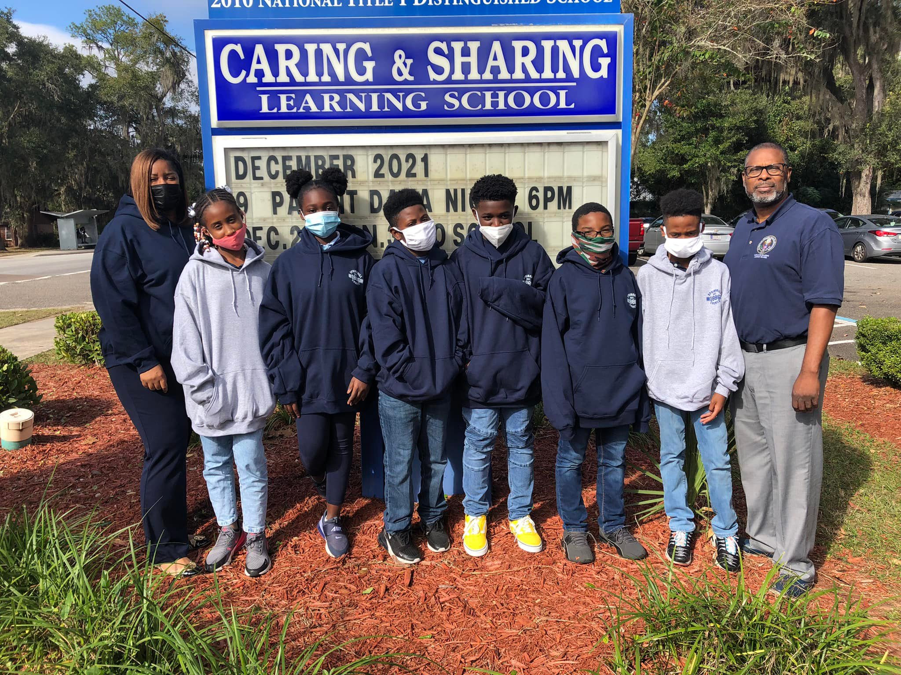
TO THE COMMUNITY AND ORGANIZATIONS THAT HAVE MADE DONATIONS TO OUR SCHOOL

Slide 6
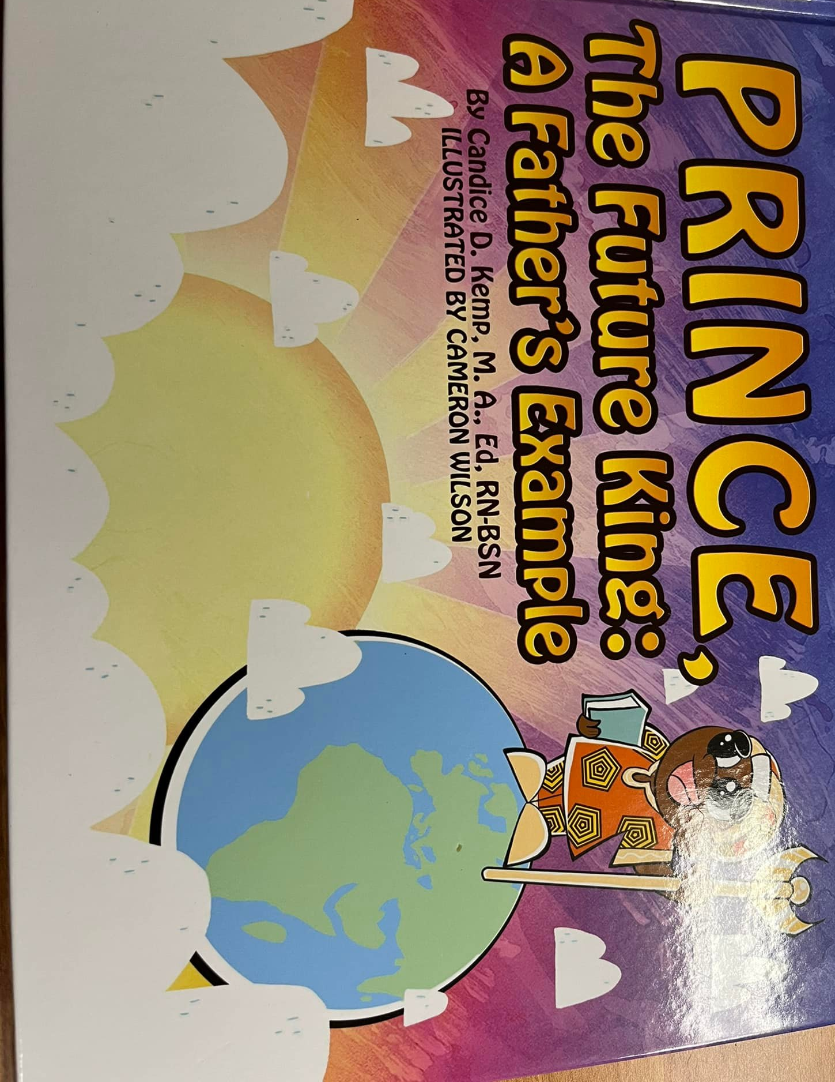
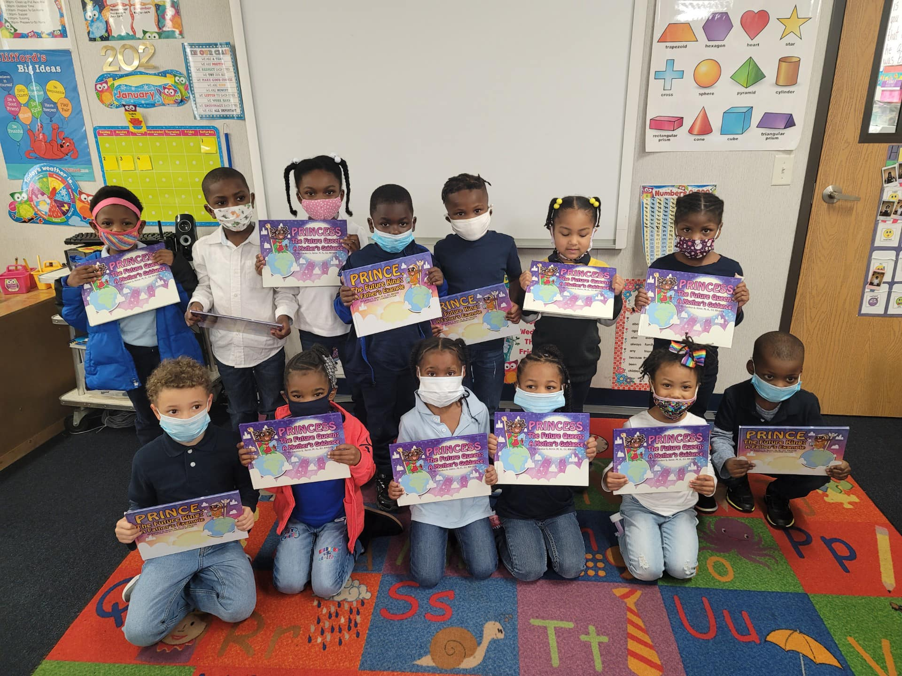

Slide 7
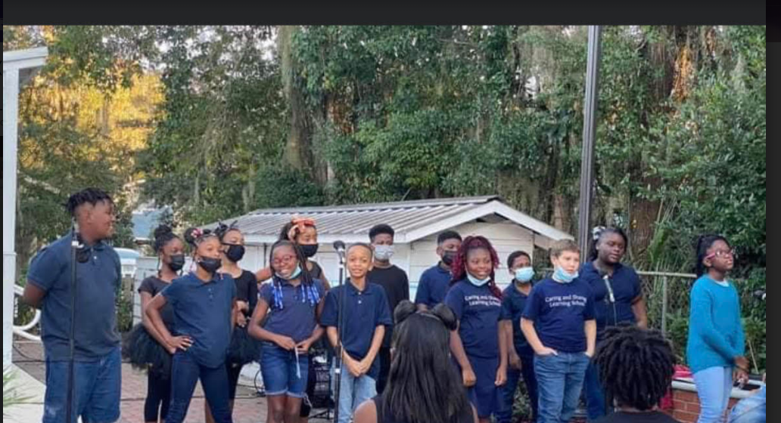
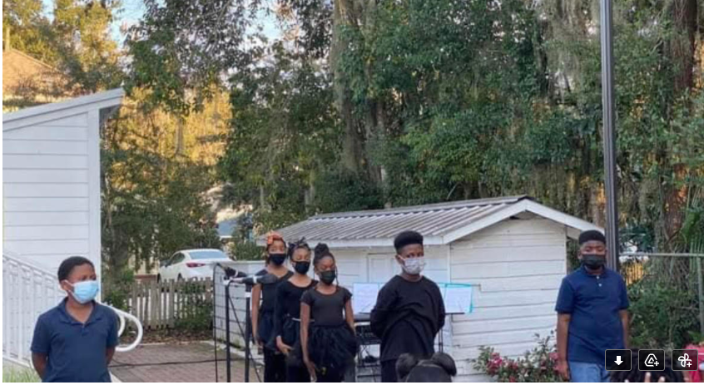
EAGLES IN THE COMMUNITY
A Quinn Jones Youth Showcase
Honoring MLK at Alachua County School Board Meeting- Tonight

Slide 8
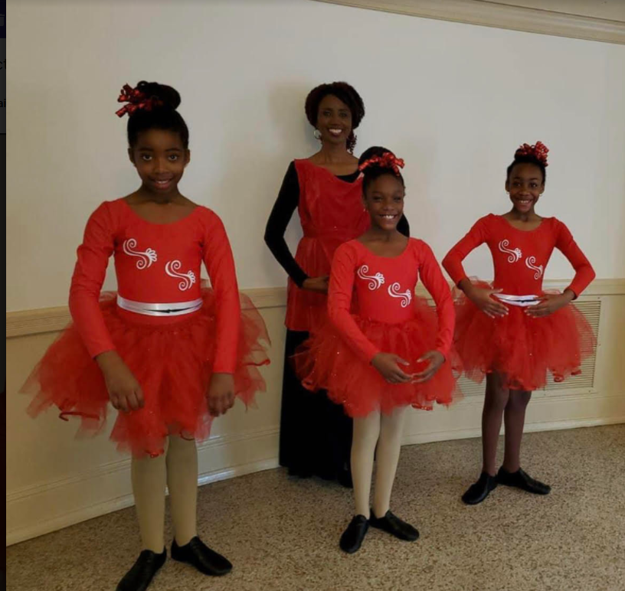
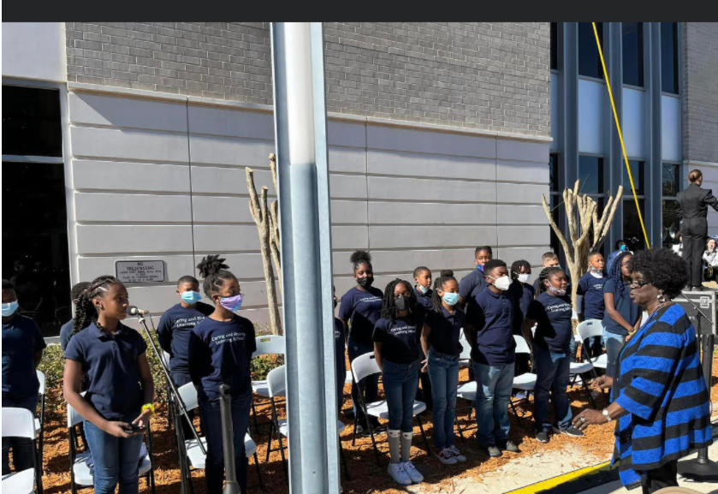
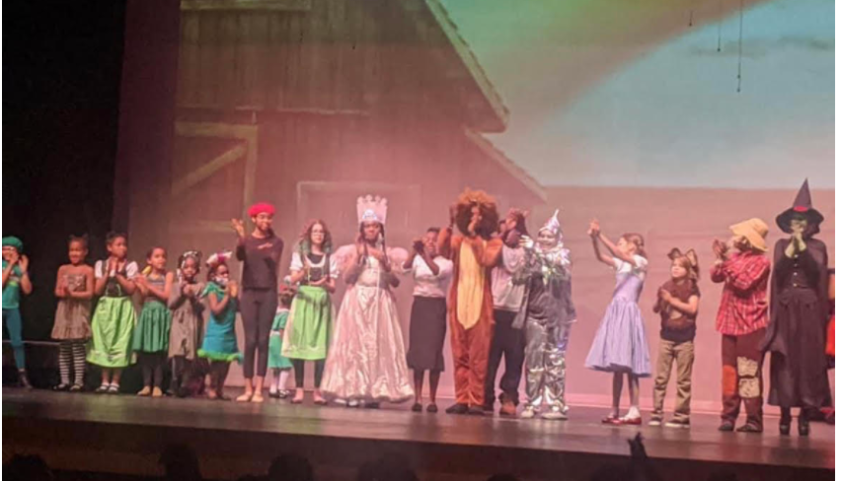
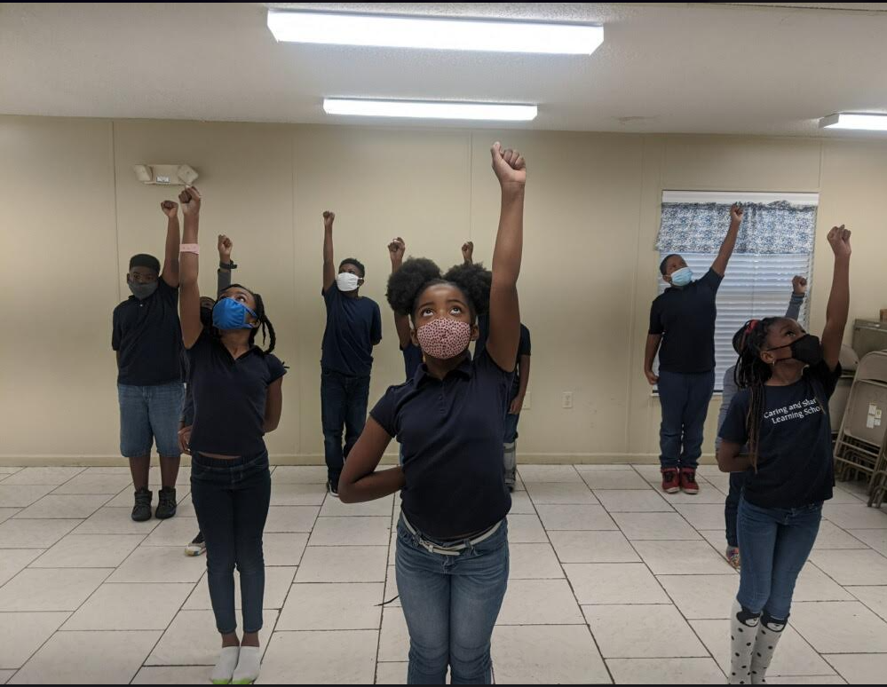
Gainesville Women’s Club
Courthouse renaming program for Judge Stephan P. Mickle Sr.
Wizard of Oz

Slide 9
FSA TESTING DATES
April
4/5th grade writing April 5th3rd ELA April 7, April 8
May
4/5 th grade ELA May 3, May 4th
3rd -5th grade Math May 9, May 10
5th grade Science May 16, May 17

Slide 10
VALENTINE DAY GRAMS
AND PHOTOS
$8.00 Dollar - medium trinket and candy
$5.00 Dollar - small trinket and candy
$1.00 Dollar - candy grab bag
$5.00 - Valentine Photo (to be delivered with the grams)
All orders will be taken via Electronic Order form and
payments will be accepted via Cash App through February 8th!
If you are unable to pay via cash app 1/21, 2/2, 2/4, 2/7 are cash collection days during drop off and pick up, please do not send money to school with the students

Slide 11
THANK YOU
PARENTS, STUDENTS, AND TEACHERS
FOR JOINING

Slide 12
EAGLE OF THE MONTH
AUGUST
Jon Parker
Jayce Neal
Sha'ryssa Forrest
Kaiden James
Baylea Carey
Kylie Jenkins
Eben James
Aaliyah Baker
Myleah Rutledge
Aleah Henderson
SEPTEMBER
Abrar Halim
Ariah Sellers
Teniola Olamina
Karrie Whitfield
Ariyanna Rentz
Pernell Thomas
Olasanya Olamina
OCTOBER
London Houston
Jayden Higgins-Jones
Brandy Griffith
Liam Jones
Alijah Cotton
Payton Hunt
Laila McClendon
Myracle Dixon
Jachi Johnson

Slide 13
EAGLE OF THE MONTH
NOVEMBER
Destah’ni Acevedo
Alaya Cason
Noah Young
Arabella Young
Bryanna Moring
Barrington Carrey
Rai'lynn Mills
Kaleb Davis
DECEMBER
McKenzie Young
Kalynn Serenity Johnson
Khloe Hodges
Nyah Parker
Channing Scott
Kimora Stuckey
Aubrey McKay
Zyon Skanes
Brady Butler

